Slide 1
Learning to Aggregate on Structured Data
Master Thesis Status Talk
Clemens Damke

Slide 2
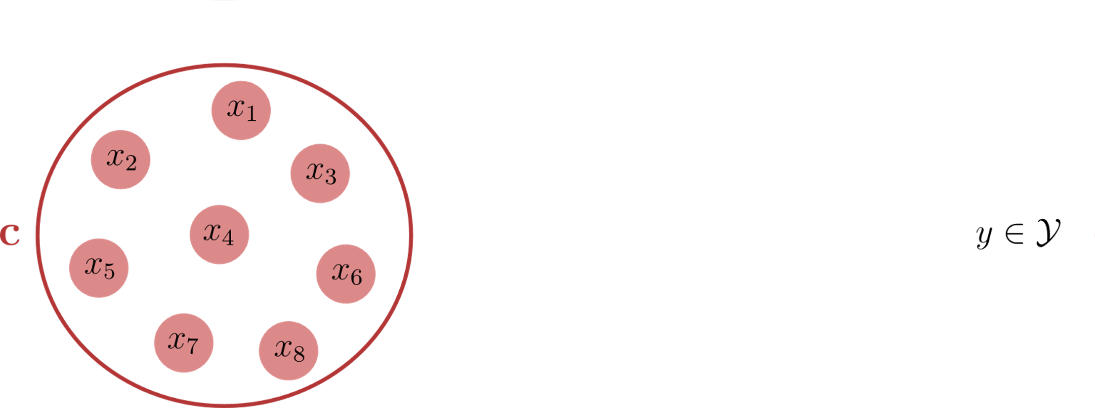
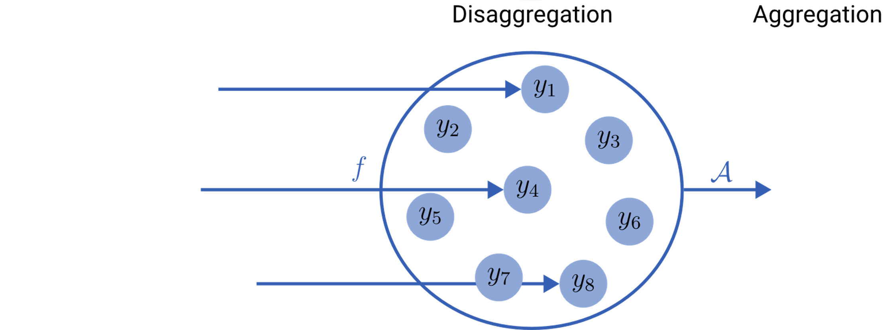
Learning to Aggregate on Unstructured Data
composition
constituent

Slide 3
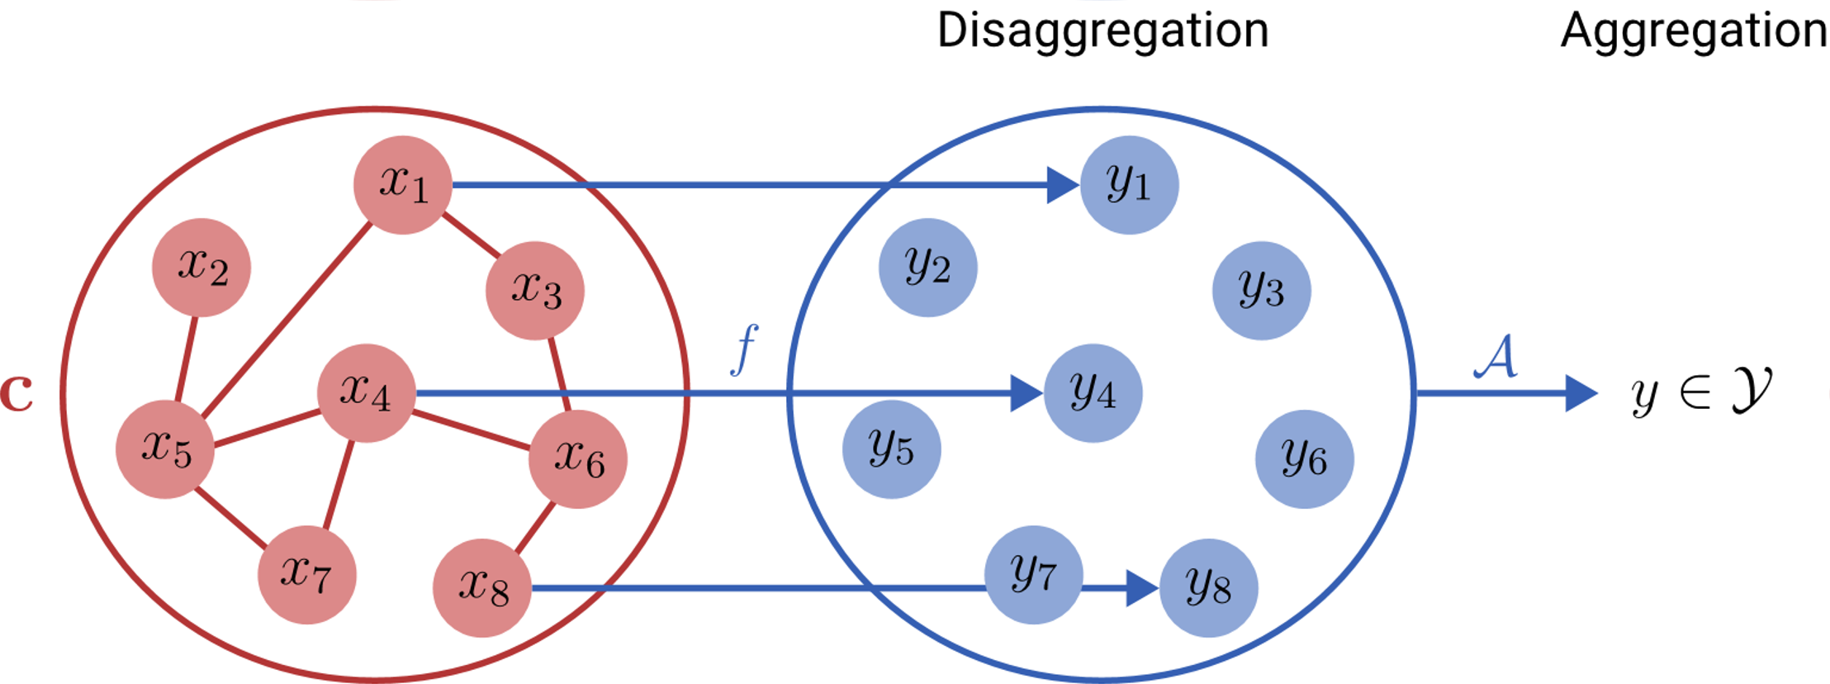
Learning to Aggregate on Structured Data
constituent
?

Slide 4
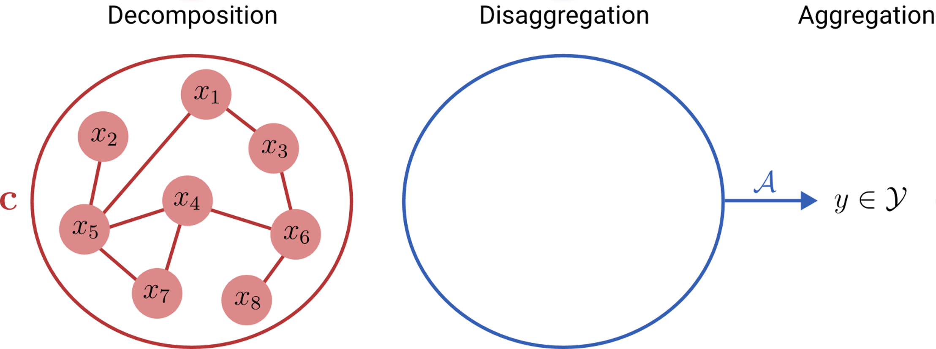
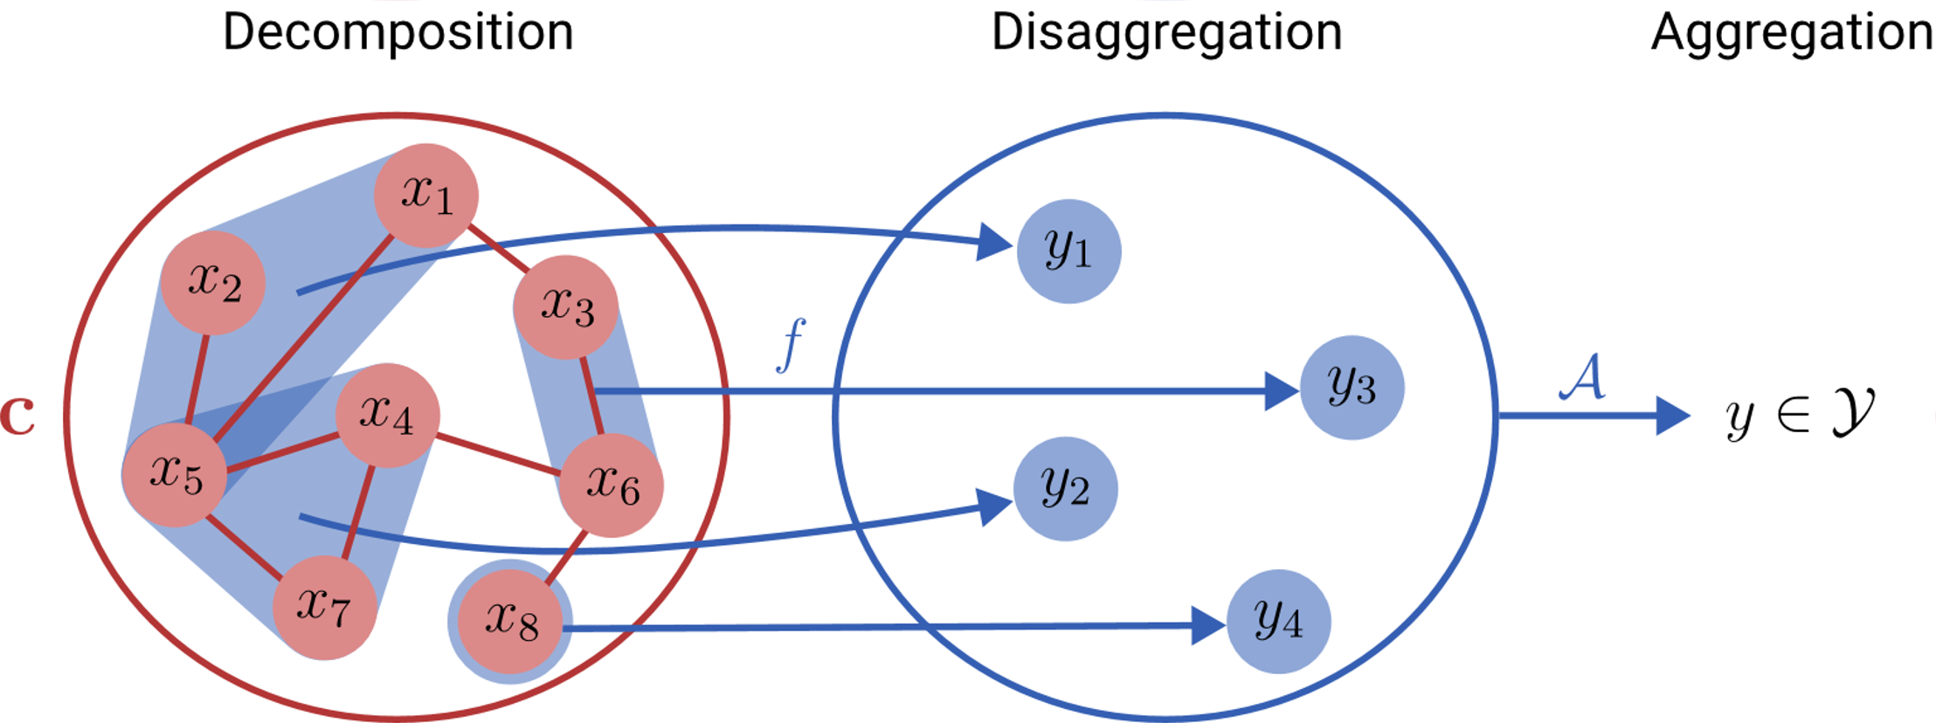
Learning to Aggregate on Structured Data
constituent
subgraph

Slide 5
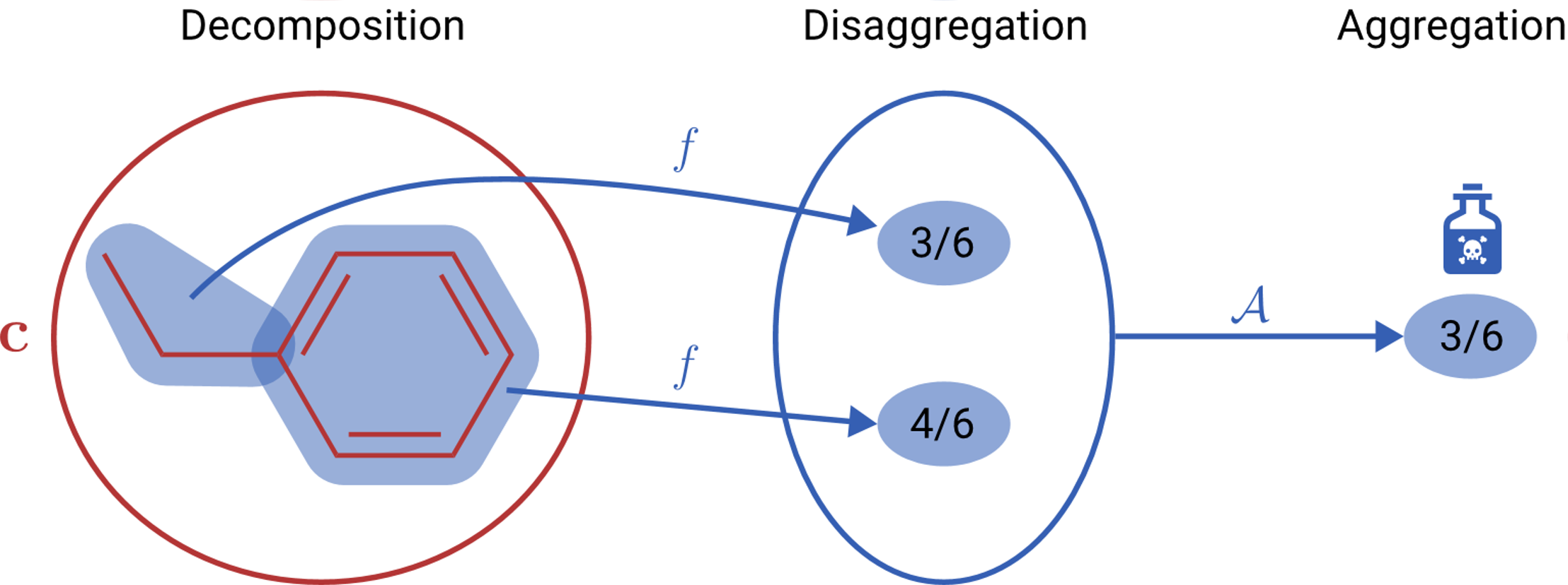
Example: Toxicity Prediction
Notes:
Ethyl + Benzene

Slide 6
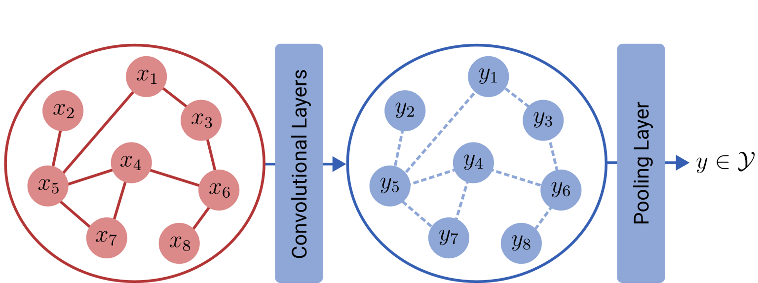
Two Perspectives
LTA on
Structured Data
Graph Convolutional
Neural Networks

Slide 7
Three Questions
Relation between convolution and disaggregation?
Relation between pooling and aggregation?
What could be improved here?
②
①

Slide 8
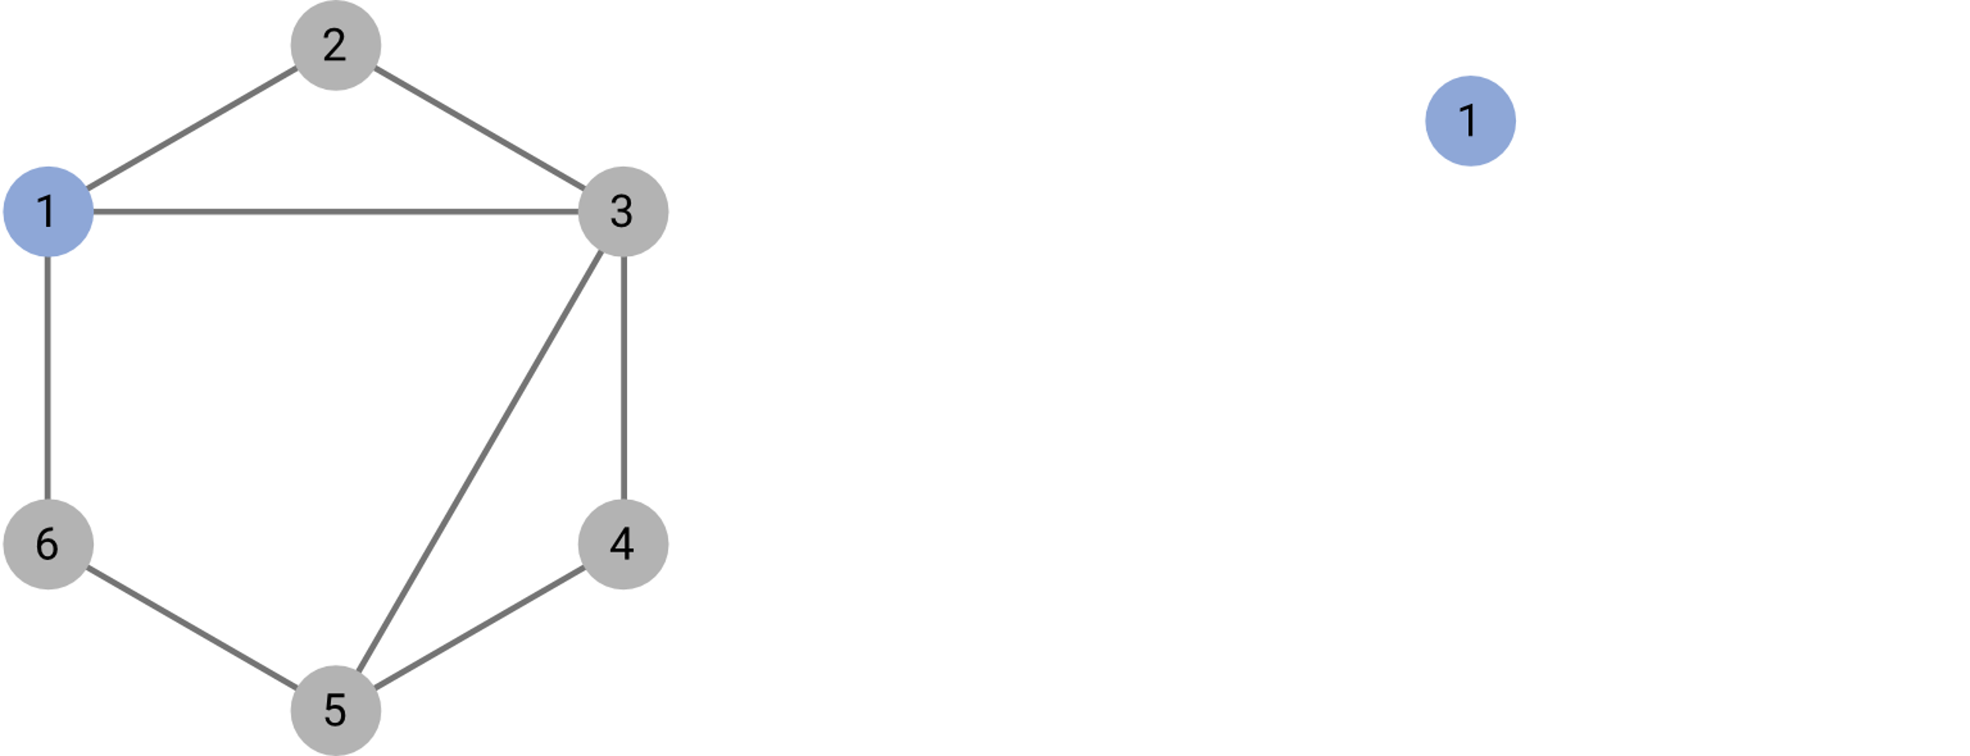
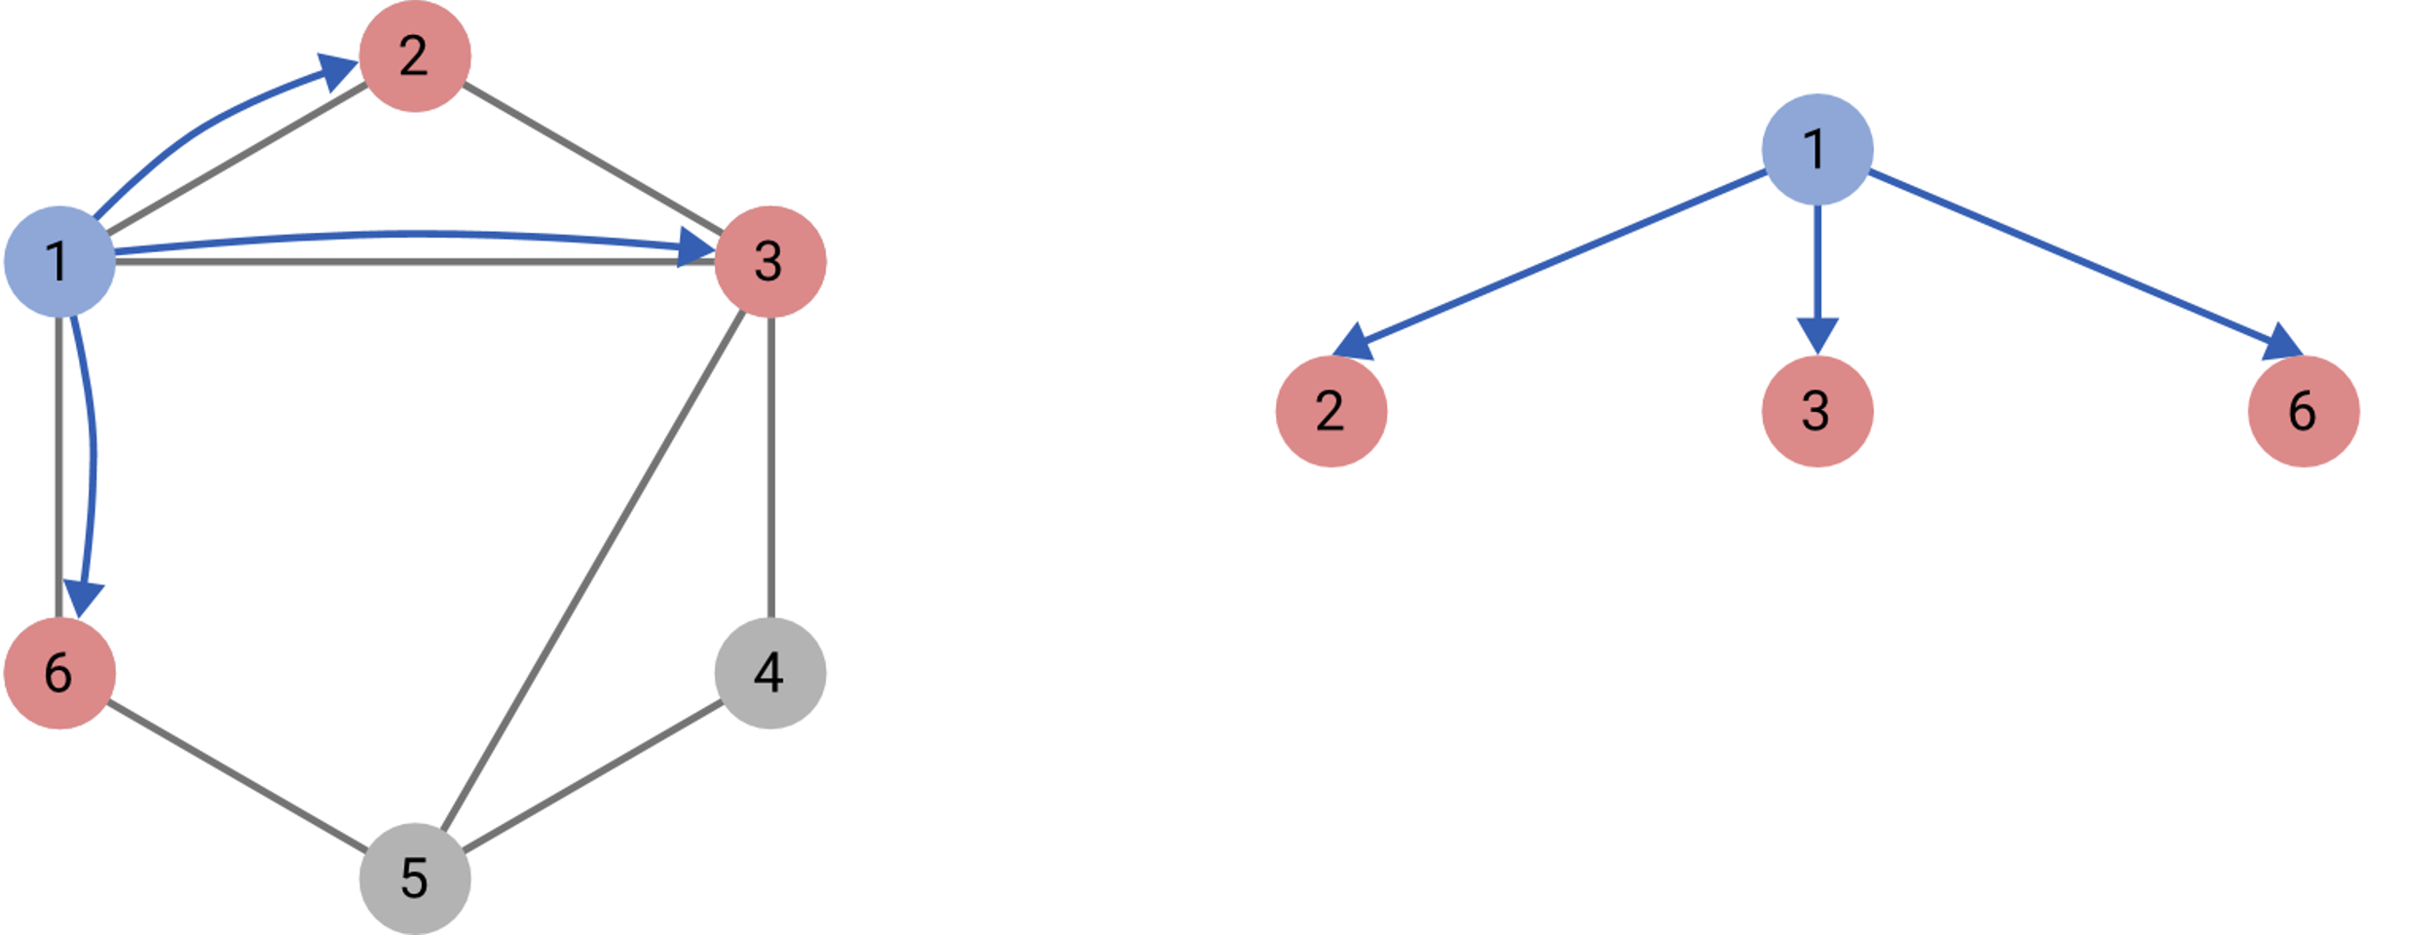
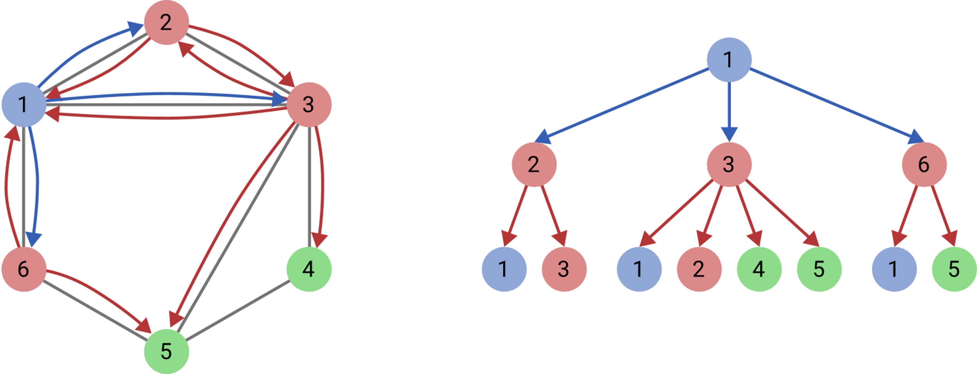
LTA Perspective on Graph Convolutions
subtree constituent

Slide 9
Three Questions
Relation between convolution and disaggregation?
Relation between pooling and aggregation?
What could be improved here?
②
①

Slide 10
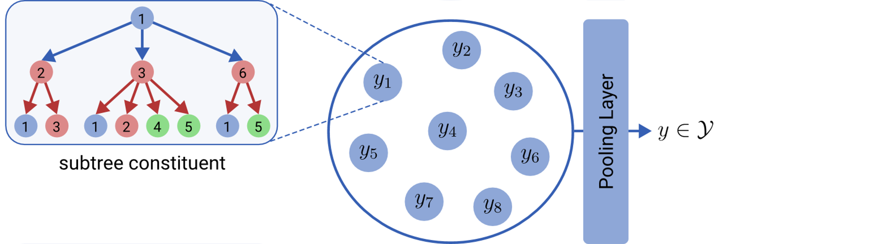
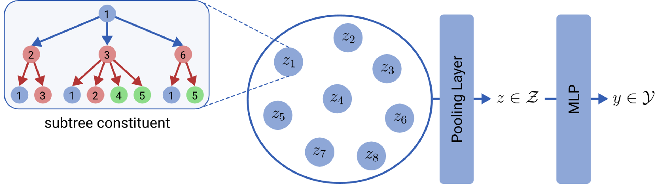
LTA Perspective on Graph Pooling
Implications?
mean
max
top-k
self-attention
OWA
…

Slide 11
Three Questions
Relation between convolution and disaggregation?
Relation between pooling and aggregation?
What could be improved here?
②

Slide 12
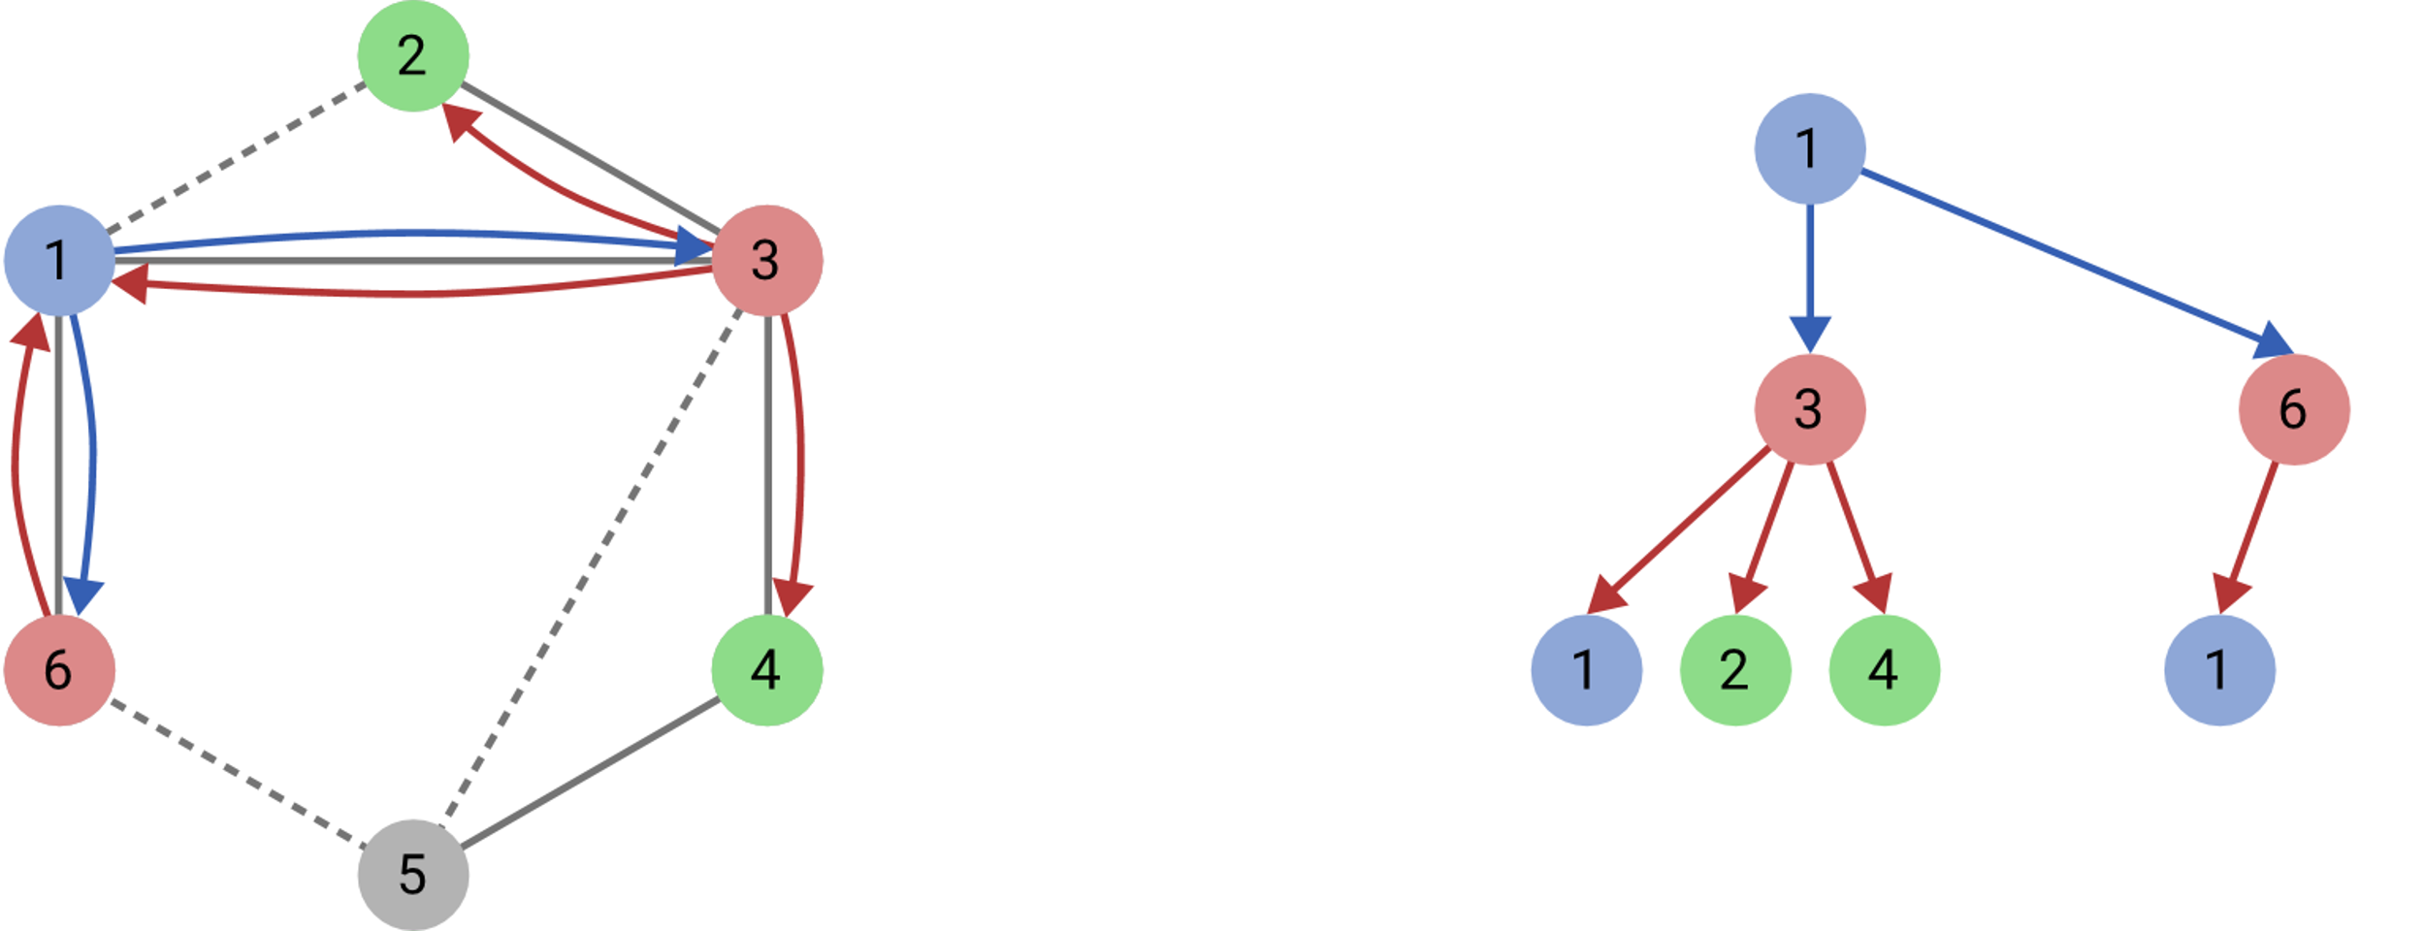
1. Drawback of Current GNNs
Constituent subtrees are statically determined by the input structure
Solution Approach: Learn constituents via an edge filter.
Edge features?

Slide 13
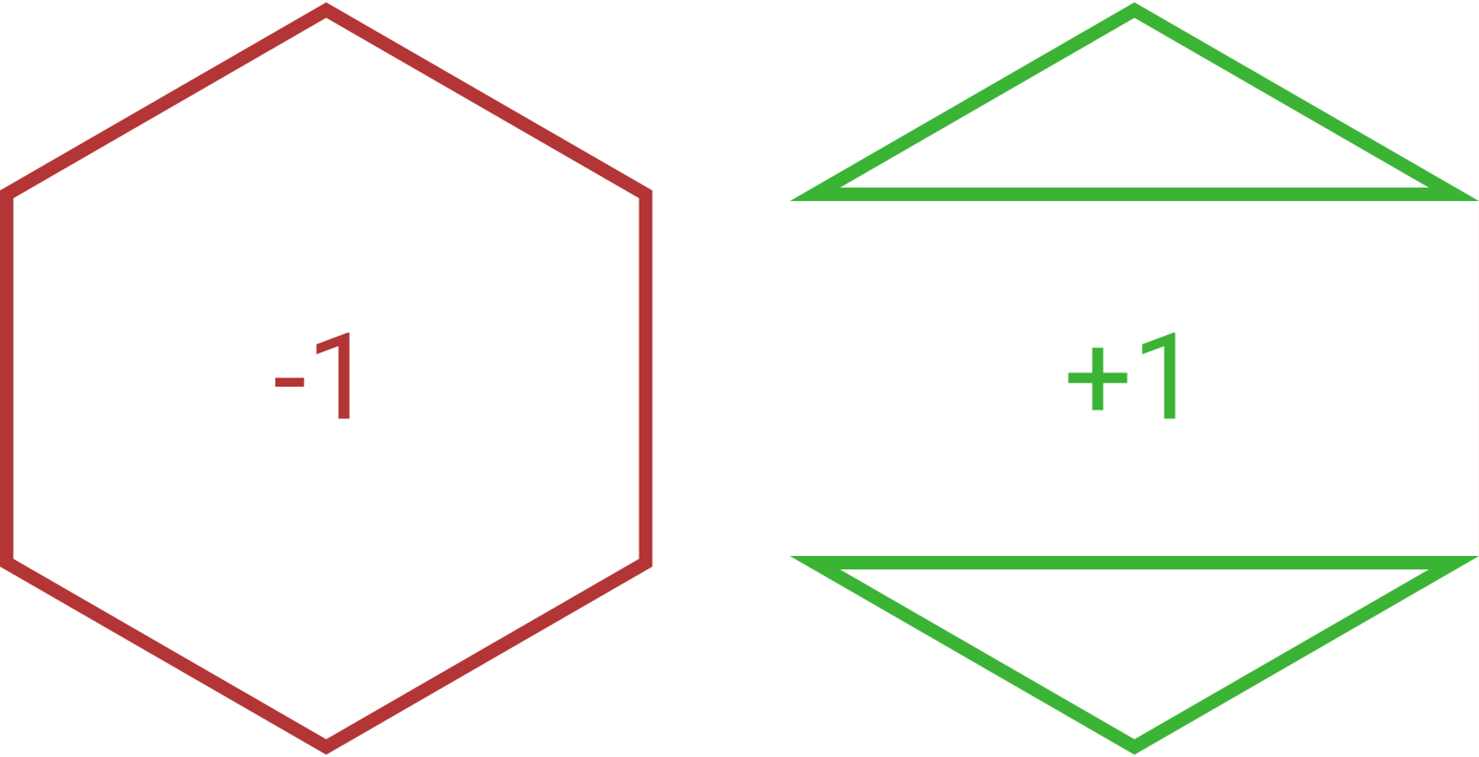
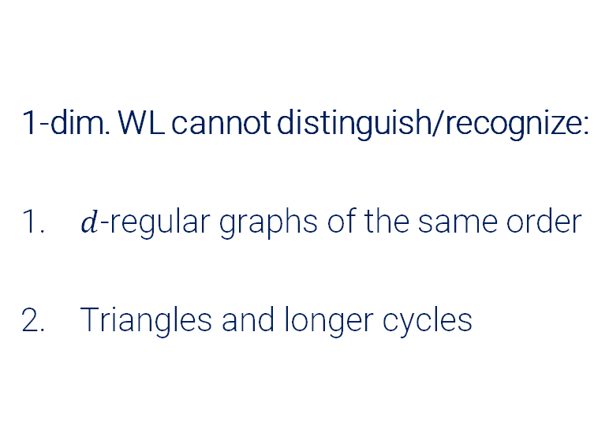
2. Drawback of Current GNNs
Discriminative power bounded by 1-dim. Weisfeiler-Lehman isomorphism check
1-dim. WL cannot distinguish/recognize:
​$d$-regular graphs of the same order
Triangles and longer cycles
Solution Approach: Use a higher dimensional graph convolution operator.

Slide 14
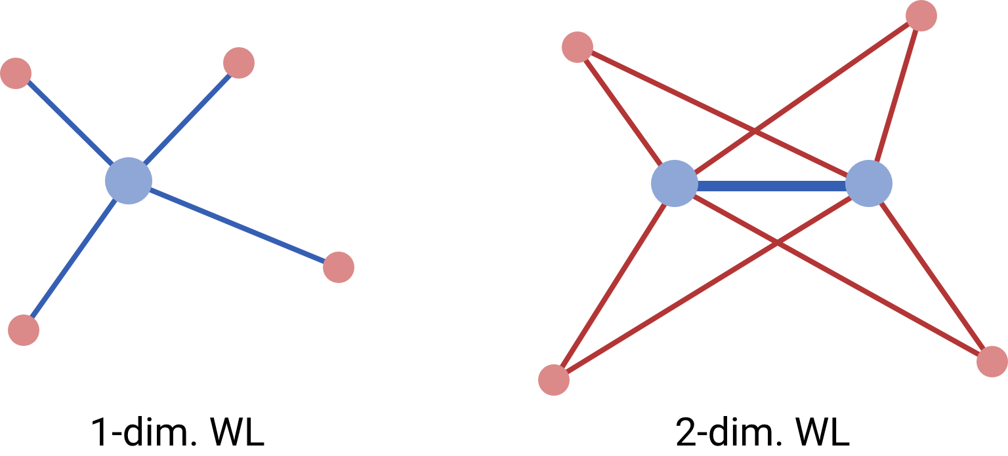
A 2-WL-bounded GNN architecture
Motivated by LTA:
Enable edge filtering
Motivated by Graph Kernels:
2-dim. WL graph convolution
2-WL-GCN
convolve over edges instead of vertices

Slide 15
Preliminary Evaluations
 | Proteins | NCI1 | D&D
2WL-GCN (mean pool) | 76.7% ±3.0% | 62.4% ± 2.9% | 71.3% ± 4.3%
DGCNN (self-attention pool + MLP) | 72.9% ±3.5% | 76.4% ± 1.7% | 76.6% ± 4.3%
GIN (sum pool + MLP) | 73.3% ±4.0% | 80.0% ± 1.4% | 75.3% ± 2.9%
GraphSAGE (max pool + MLP) | 73.0% ±4.5% | 76.0% ± 1.8% | 72.9% ± 2.0%
Baseline (mean pool + MLP) | 75.8% ±3.7% | 69.8% ± 2.2% | 78.4% ± 4.5%

Slide 16
Summary
Relation between convolution and disaggregation?
Relation between pooling and aggregation?
What could be improved here?

